Slide 1
Town of Kernersville cistern car wash
Wendi Hartup Stormwater Manager

Slide 2
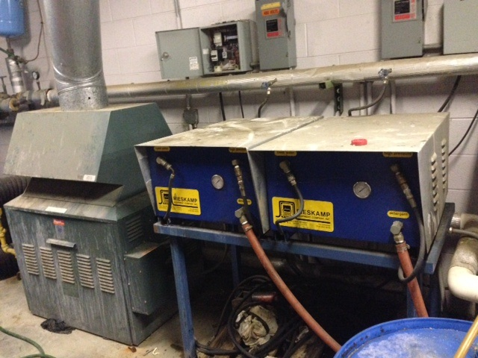
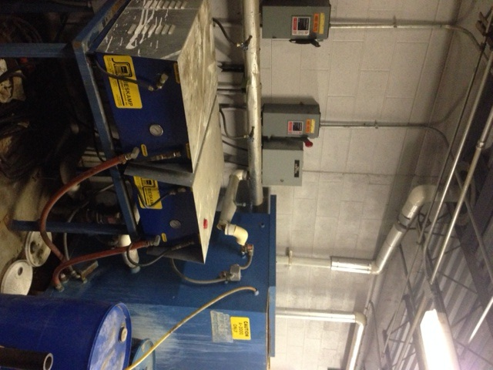
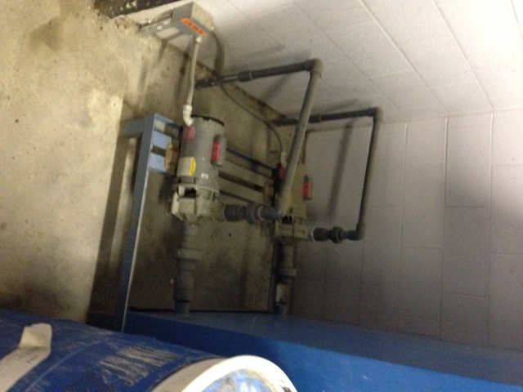
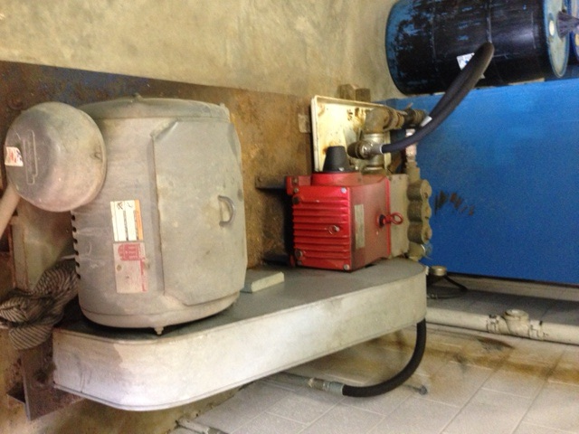
Why did we do a car wash with cisterns?
Original car wash was built in 1994.
During the last 3 years of maintenance the following issues:
Outsourced maintenance cost: $3200
In-house parts cost: $450
Carwash down time: 61 days
Town employee labor: 36 hours
Estimated cost to repair existing system: $22,000 (1 to 5 years life expectancy after repairs)

Slide 3
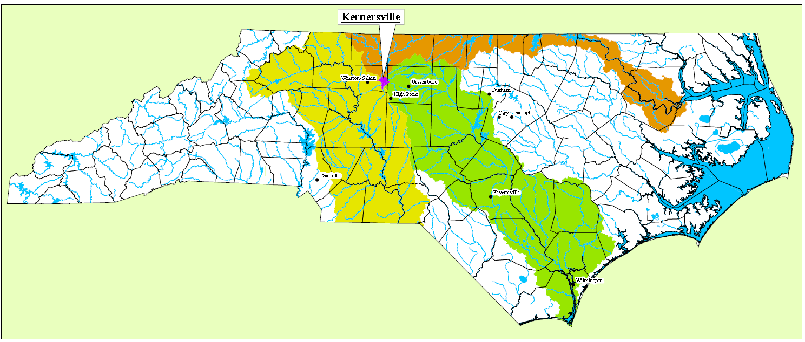
Why did we do a car wash with cisterns?
Objectives:
Serves as a great model and educational tool for the community
Save potable water
Remove Nitrogen and Phosphorus from rooftop runoff
As a North Carolina Stormwater Phase II community, wanted to implement a water quality improvement for Good Housekeeping and Pollution Prevention Measure

Slide 4
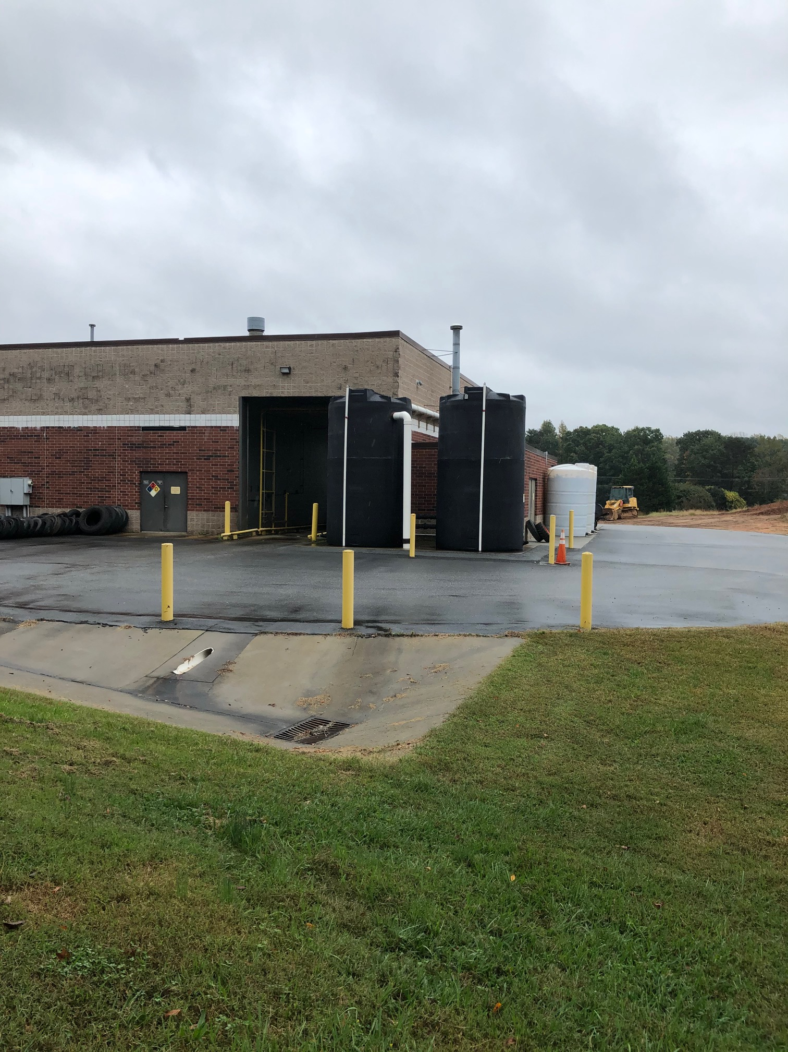
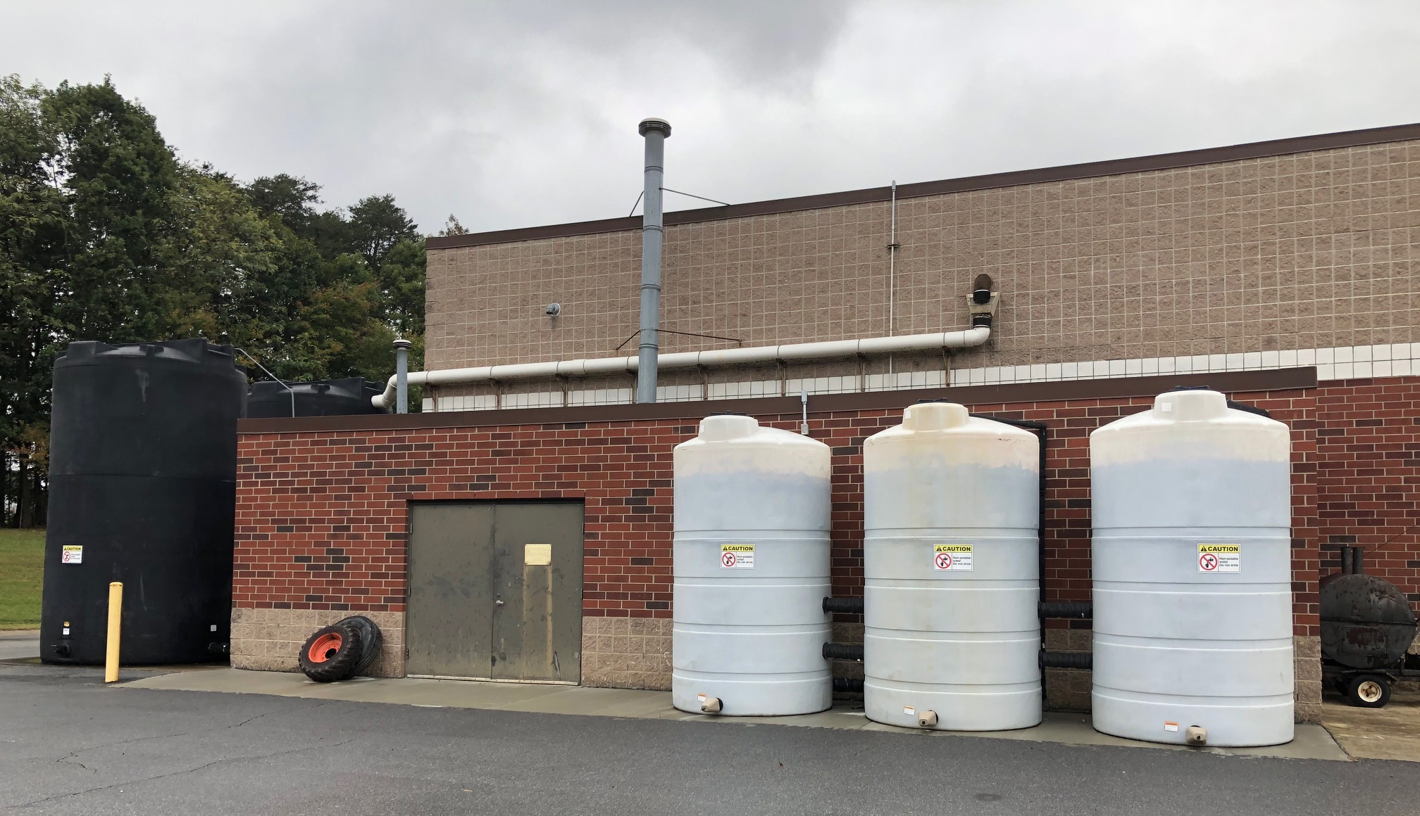
Installed 2015
12000 sq ft rooftop is captured
Monthly average captured water: 21,000 gallons
Two 6,000 gallons cisterns for storage of rain water
Three 3,000 gallon cisterns for water reuse during wash
Average of 15 washes per day totaling 1,740 gallons of water used daily.

Slide 5
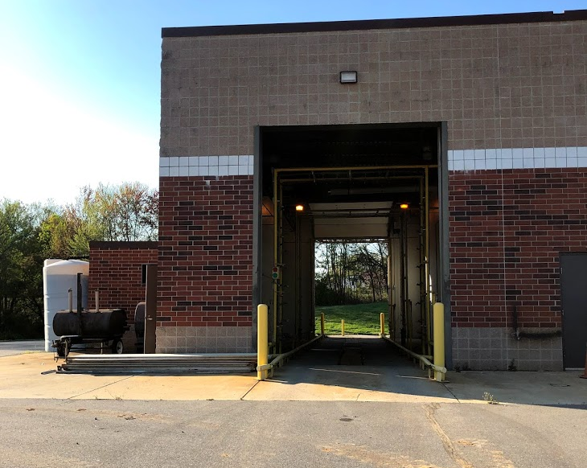
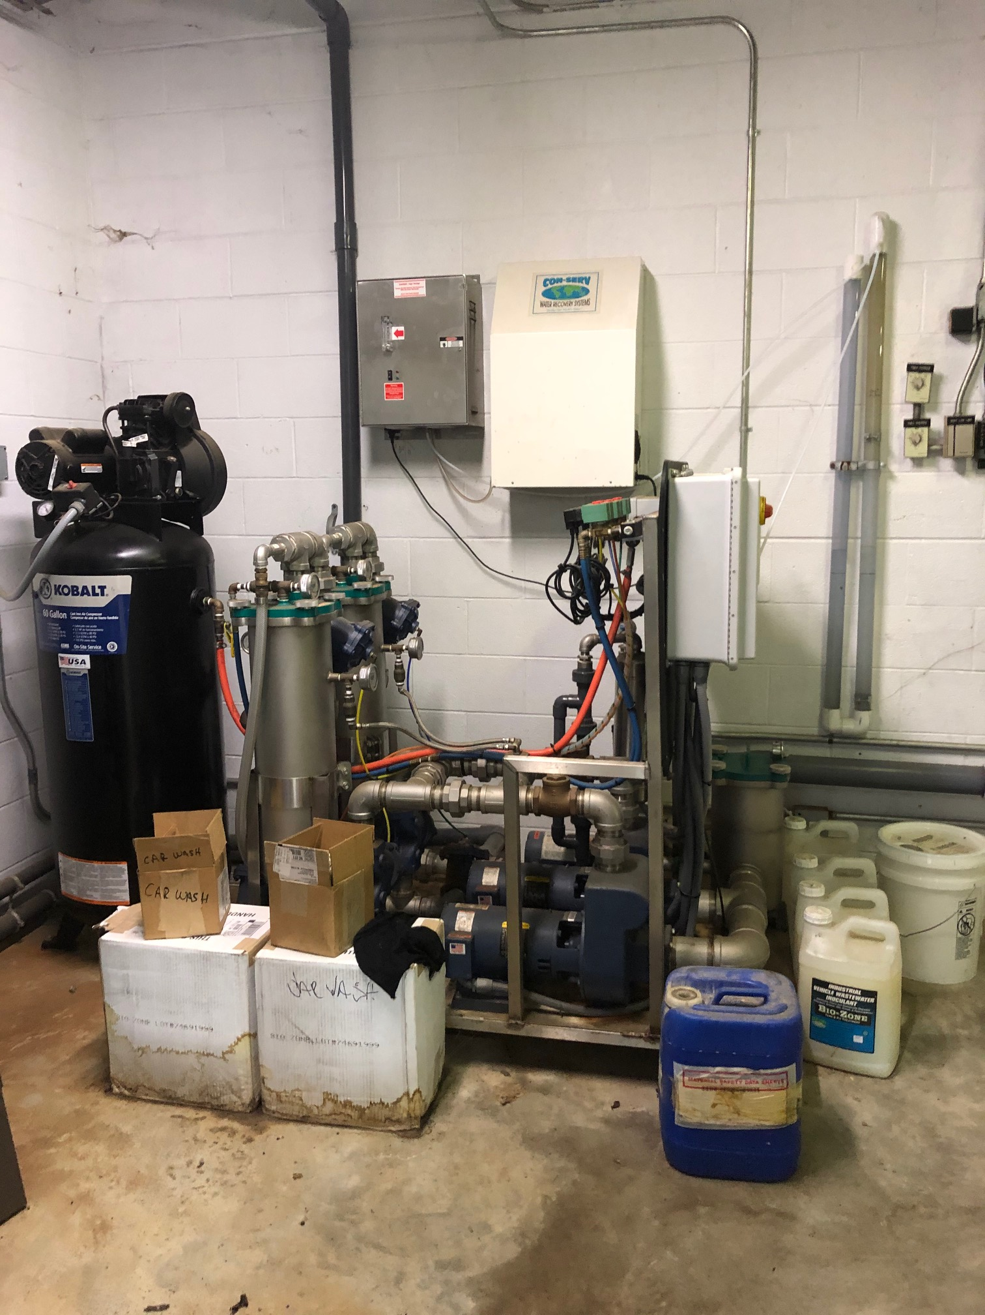
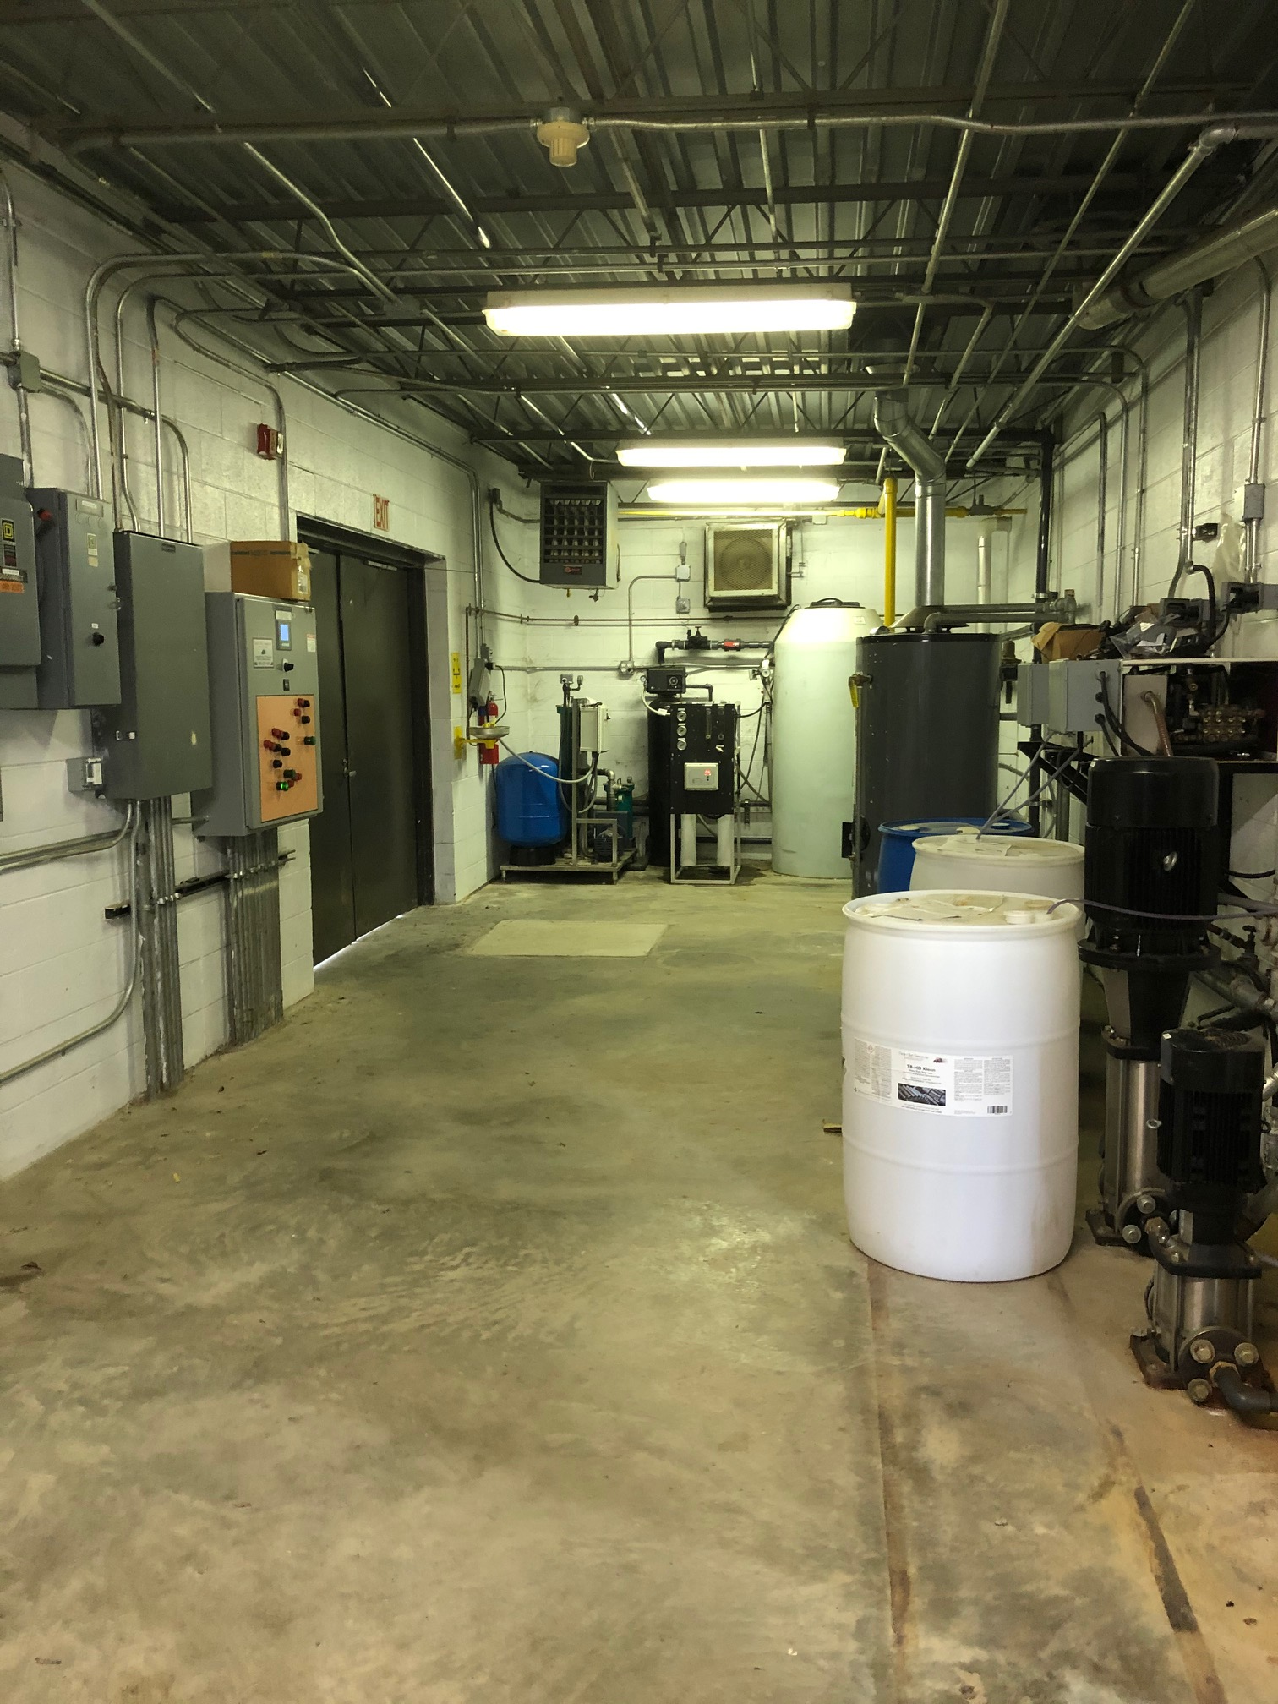
Costs:
Truck wash $89,852
Water Reclaim System for recovering all water used in Truck Wash $71,664
Rainwater Recovery System to catch rainwater from rooftop $26,659
TOTAL: $188,176

Slide 6
Cost savings
OLD SYSTEM: 2013 $545 2014 $556
AFTER INSTALL: 2015 $196
Saved money overall??? We haven’t analyzed that in quite a while.
-Staff usually fixes issues.
-No supplements with potable water yet!
-Most all Town employees use

Slide 7
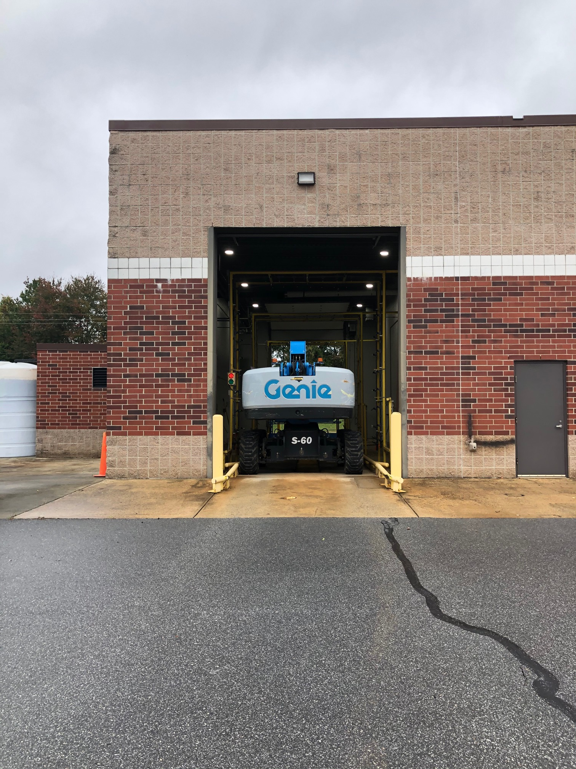
Challenges
Preventative maintenance vs reactive maintenance
Down time when not working and using water
Finding service companies vs staff fixing issues
Only a rinse off with brushes. Not useful for trash truck washing.

